Slide 1
HOUSE RENT APP USING MERN
TEAM MEMBERS
NARA UTTEJ
ARIGELA THRINESH
DASARI BHARATH
AVULA DEVI VARA PRASAD

Slide 2
ABSTRACT
The need for creative solutions that streamline the home-finding and rental process has been fueled by the real estate industry's growing desire for digital platforms.
This project presents the development of a House Rent Application using the MERN stack, that comprises of MongoDB, Express.js, React.js, and Node.js.
The application offers a modern and effective platform for listing and renting homes, facilitating smooth communication between landlords and tenants.

Slide 3
.
INTRODUCTION
The House Rent App is an easy-to-use tool made to make renting out and managing properties easier.
This software provides both tenants and landlords with a simple and effective way to list their properties or find a new place to live.
The app's sophisticated search filters, safe payment integration, and real-time communication tools facilitate the process of matching renters with rental homes that suit their individual requirements.

Slide 4
EXISTING SYSTEM
However, there are several limitations associated with such a system that can impact its overall performance and user experience, if the app gains a large user base; the MERN stack may struggle with managing high traffic and large databases without significant optimization.
The use of real-time features like chat or notifications may also lead to performance issues if not carefully managed.
Tenants can search for apartments based on location, price, and preferences on traditional rental websites, which typically allow property owners to display available rents. These systems are less effective and more difficult to maintain since they frequently rely on different technologies for front-end and back-end functions.
Traditional rental websites generally allow property owners to list available rentals, and tenants can search for properties based on location, price, and preferences. These systems often rely on separate technologies for front-end and back-end operations, making them less efficient and harder to maintain.

Slide 5
PROPOSED SYSTEM
The proposed system will be built using the MERN stack
User-friendly interface:
The app offers a responsive design, easy navigation, and personalized dashboards.
Real-time scheduling:
The platform offers real-time availability, instant booking, live notifications, and messaging for efficient rental management.
Secure User Authentication and Authorization :
The platform uses JWT for secure user access and role-based authorization for landlords and tenants.

Slide 6
Payment Integration :
The platform integrates Stripe or PayPal for secure payments and allows users to track their transaction history.
Reviews and Ratings :
Tenants can leave reviews for properties and rate landlords, fostering transparency and informed decisions.
Admin Panel and Management :
The admin panel enables system management, user monitoring, and dispute resolution for landlords and tenants.
Scalability and Performance:
The platform uses MongoDB for scalable data storage and a Node.js backend for fast, efficient API services.

Slide 7
FUTURE IMPLEMENTATIONS
Advanced Search and Filtering
User Profile Customization
Mobile Application
Multilingual Support
Automated Booking and Payment Systems

Slide 8
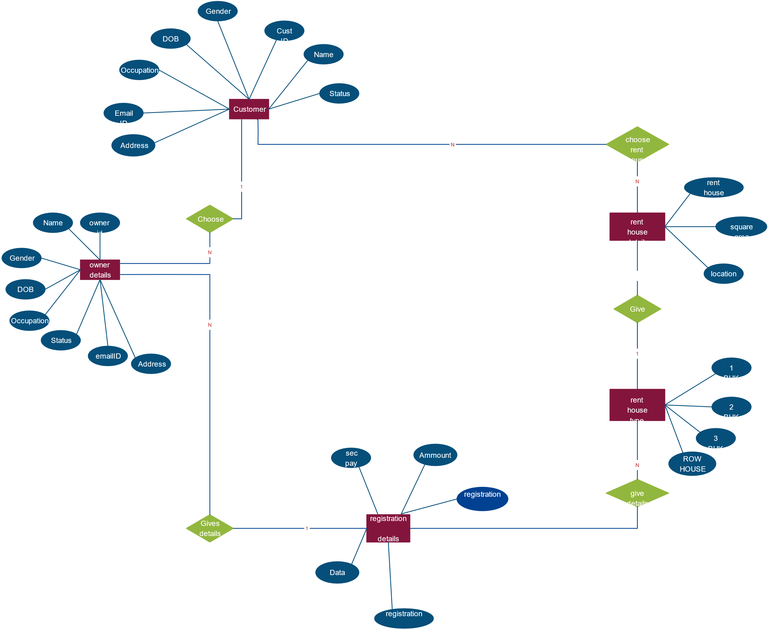
ER DIAGRAM

Slide 9
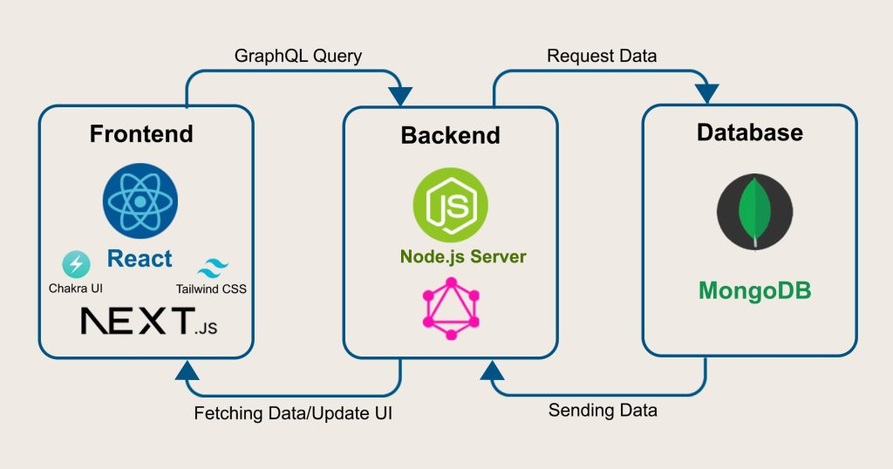
ARCHITECTURE DIAGRAM

Slide 10
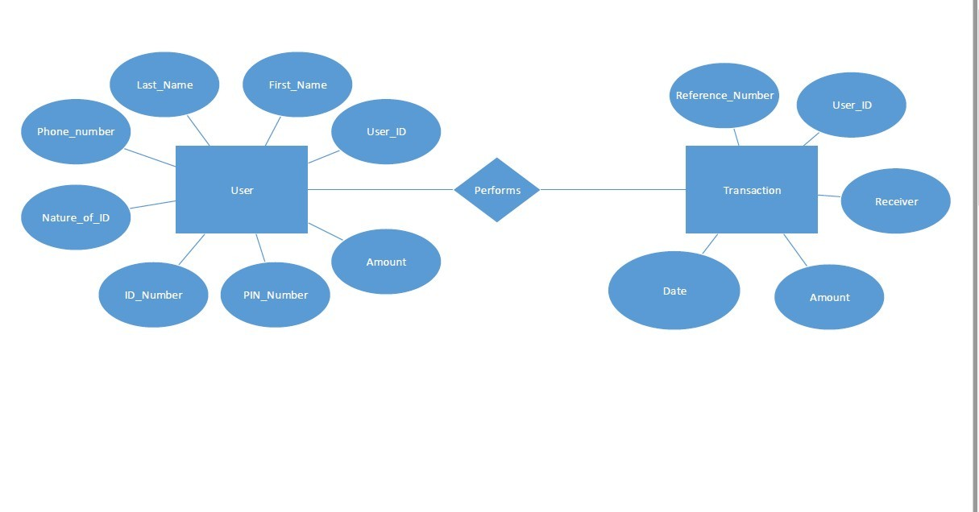
FLOW DIAGRAM

Slide 11
FRONT-END DEVELOPMENT
The frontend is built using React.js to create a responsive and interactive user interface.
Technologies Used:
React , HTML, CSS, Bootstrap.
React components handle the Booking scheduling process and user interactions dynamically. It includes components like the House Rent search page, Managing booking form, and user login/signup features.
JWT (JSON Web Tokens) is implemented to provide secure login and authentication.
Features like real-time status updates and notifications are implemented using React's state management.

Slide 12
BACK-END DEVELOPMENT
The backend of the House Rent App using Mern is built using Node.js and Server.js, providing the core functionality for managing bookings , user data, and communication between the frontend and database.
Database Design:
Users: Stores landlords/tenants’ details
Properties: Stores property details (owner, price, location)
Bookings: Manages tenant bookings
Payments: Handles payment transactions

Slide 13
BACK-END DEVELOPMENT
API ENDPOINTS:
Users: Register, login, profile management
Properties: CRUD (Create, Read, Update, Delete) for properties
Bookings: Manage bookings (create, update, cancel)
Payments: Process payments
4 Authentication JWT For user authentication Role-based Access Separate permissions for landlords and tenants

Slide 14
BACK-END DEVELOPMENT
Database Management (MongoDB):
MongoDB is used as the NoSQL database for the house rent application, storing crucial data such as user profiles, house listings, rental agreements, and user reviews.
Data is organized into collections (e.g., Users, Houses, Appointments) and is managed using Mongoose, which is a MongoDB Object Data Modeling (ODM) library.
Mongoose provides schemas to define the structure of the data, enabling data validation and ensuring smooth interactions with MongoDB.

Slide 15
INTEGRATION
The frontend (React.js) interacts with the backend through RESTful APIs. React makes GET and POST requests to the server, which processes data and returns appropriate responses.
The backend communicates with MongoDB using Mongoose for managing user profiles, house listings,bookings and reviews. API requests fetch and update this data in real-time.
The backend uses JWT tokens for secure user authentication. When users log in or sign up, their credentials are validated, and a token is returned to allow access to protected routes.

Slide 16
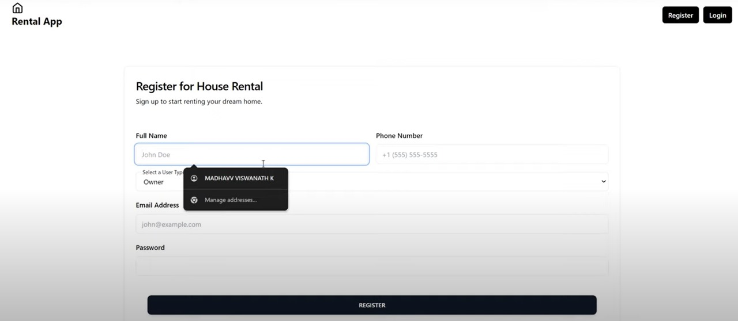
MODEL
REGISTERATION PAGE

Slide 17
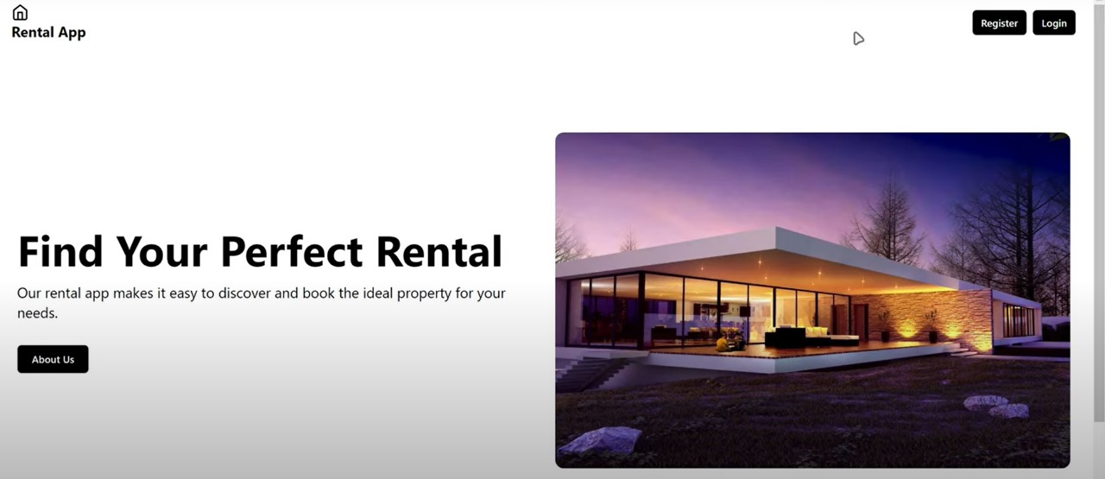
HOME PAGE

Slide 18
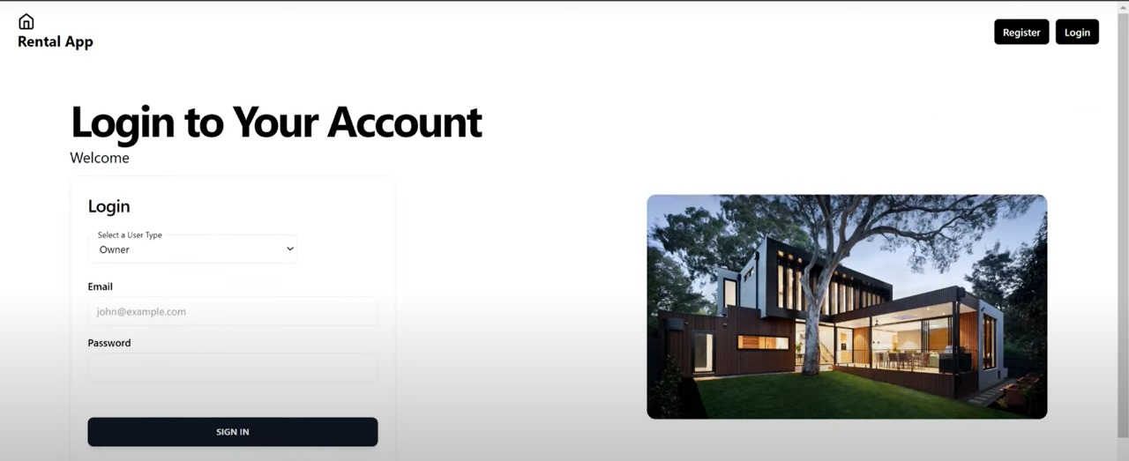
LOGIN PAGE

Slide 19
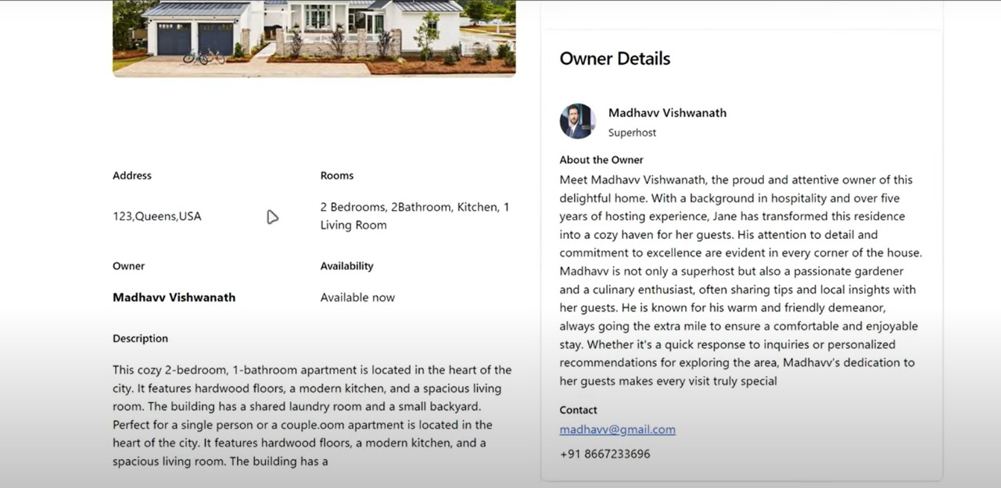
HOUSE DETAILS

Slide 20
CONCLUSION
This project, “HOUSE RENT APPLICATION USING MERN,” offers a robust solution to modernize the house rental process. It is built using scalable web technologies that enhance the user experience for both tenants and landlords while streamlining property management workflows.The application exemplifies how the MERN stack can be used to develop responsive and efficient web applications in the real estate sector. With features such as user registration, house listings, booking management, and secure authentication, it addresses the needs of users in a digital marketplace, making the house rental experience more accessible and efficient

Slide 21
THANK YOU

